Slide 1




Tenant wide extensions manager 🚀
A modern management solution for your tenant wide extensions
Dan Toft
Microsoft 365 Consultant Denmark
Blog.Dan-Toft.dk
@Tanddant
Notes:
Consulta

Slide 2
Agenda
Demo
Why built it?
Code
Summary

Slide 3

Why
Curiosity, can it be done? 🤔
Developers are unaware of the option to manage settings on their tenant wide extensions
Frustrations with the classic SharePoint Experience
Might be useful for other solutions (MOTD application customizer?)
Notes:
What’s possible – could we use the properties to improve the experience?
Demonstrating the option to use extension properties
Vesa failed – Community call May 30th 2023 @ 52 minutes
Save network traffic

Slide 4
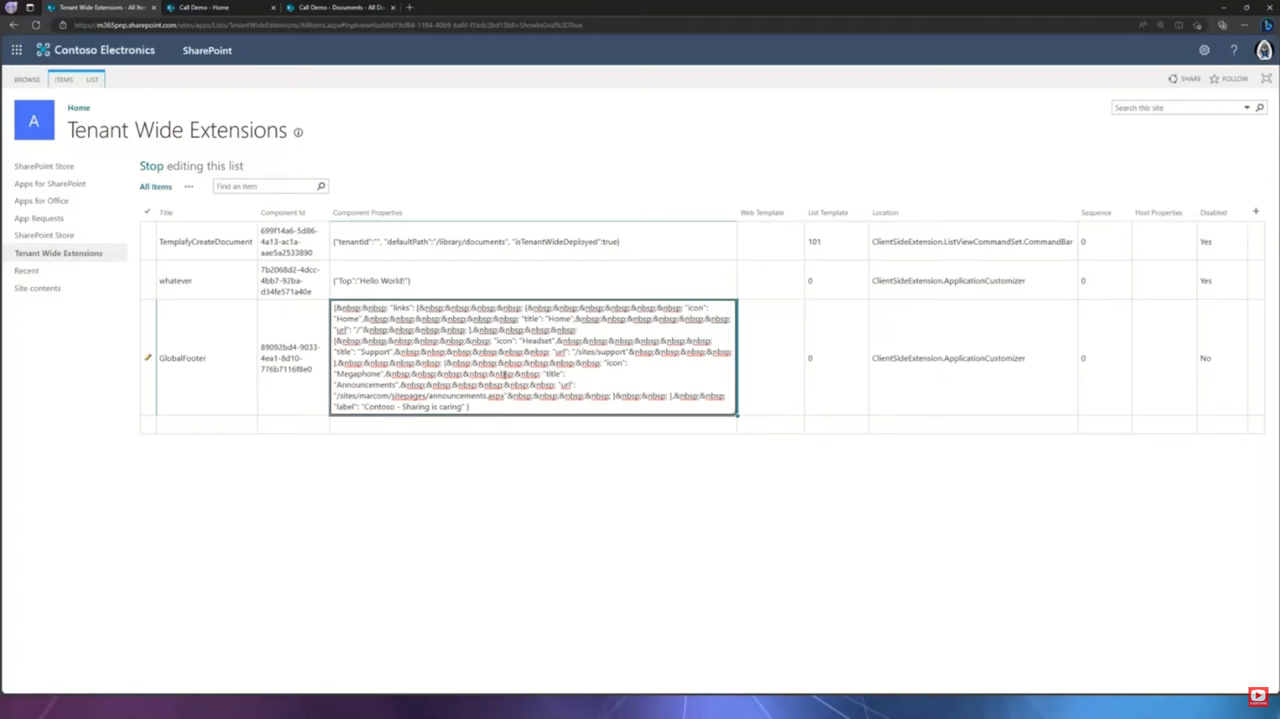

Slide 5

Demo
Notes:
Dan

Slide 6
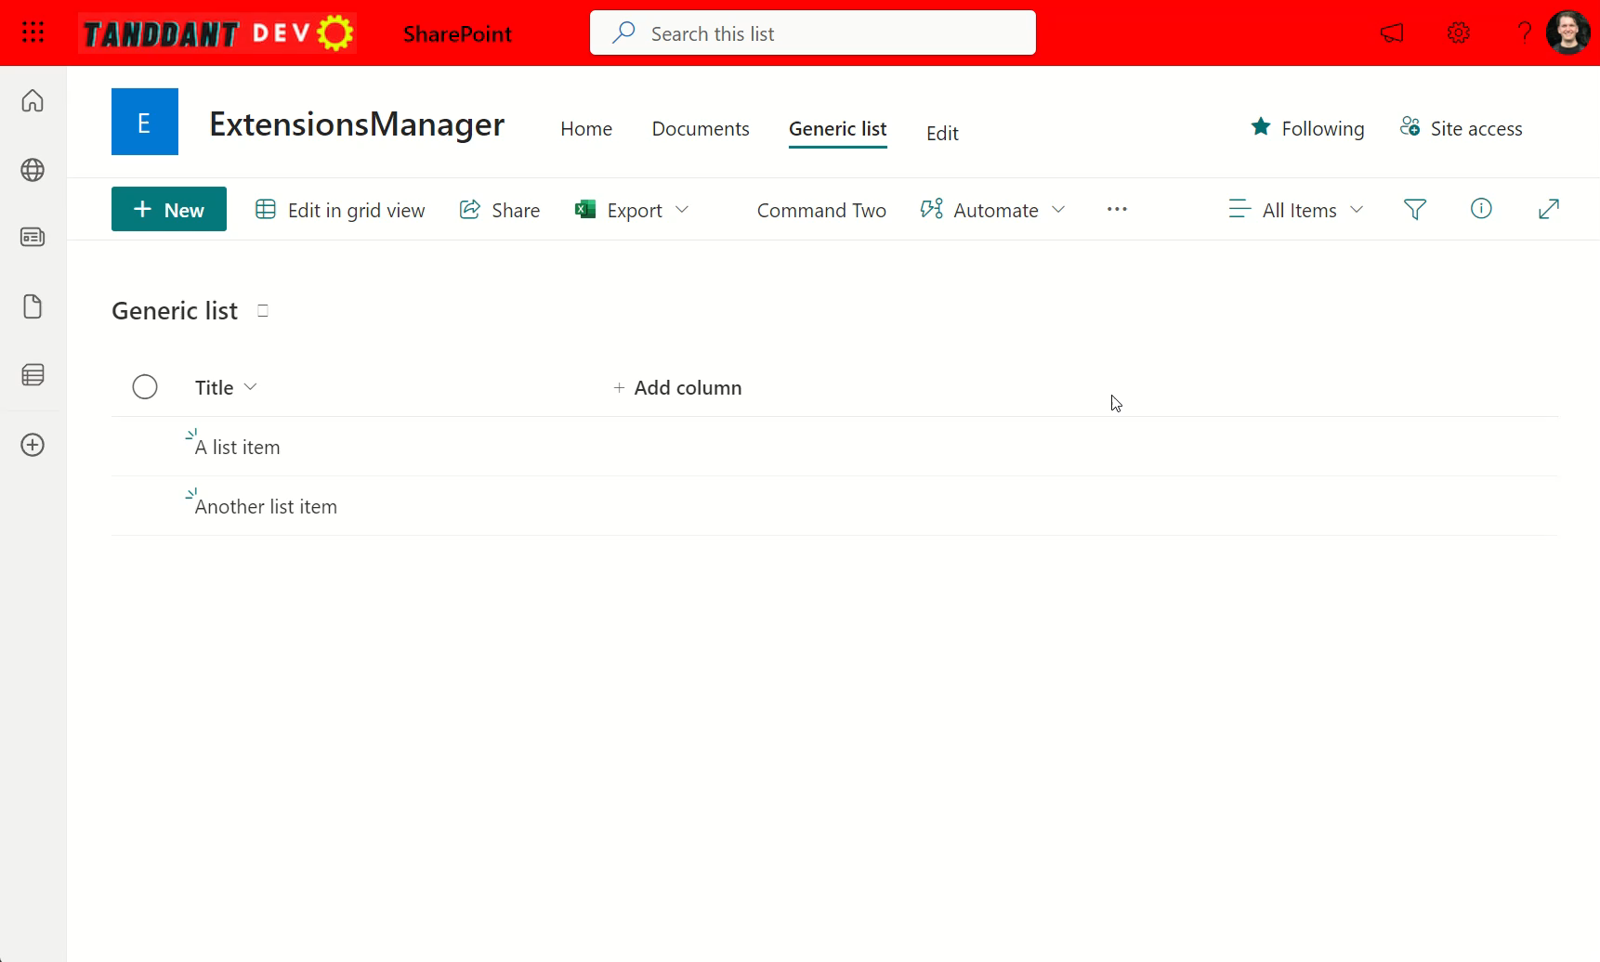
Notes:
Backup

Slide 7
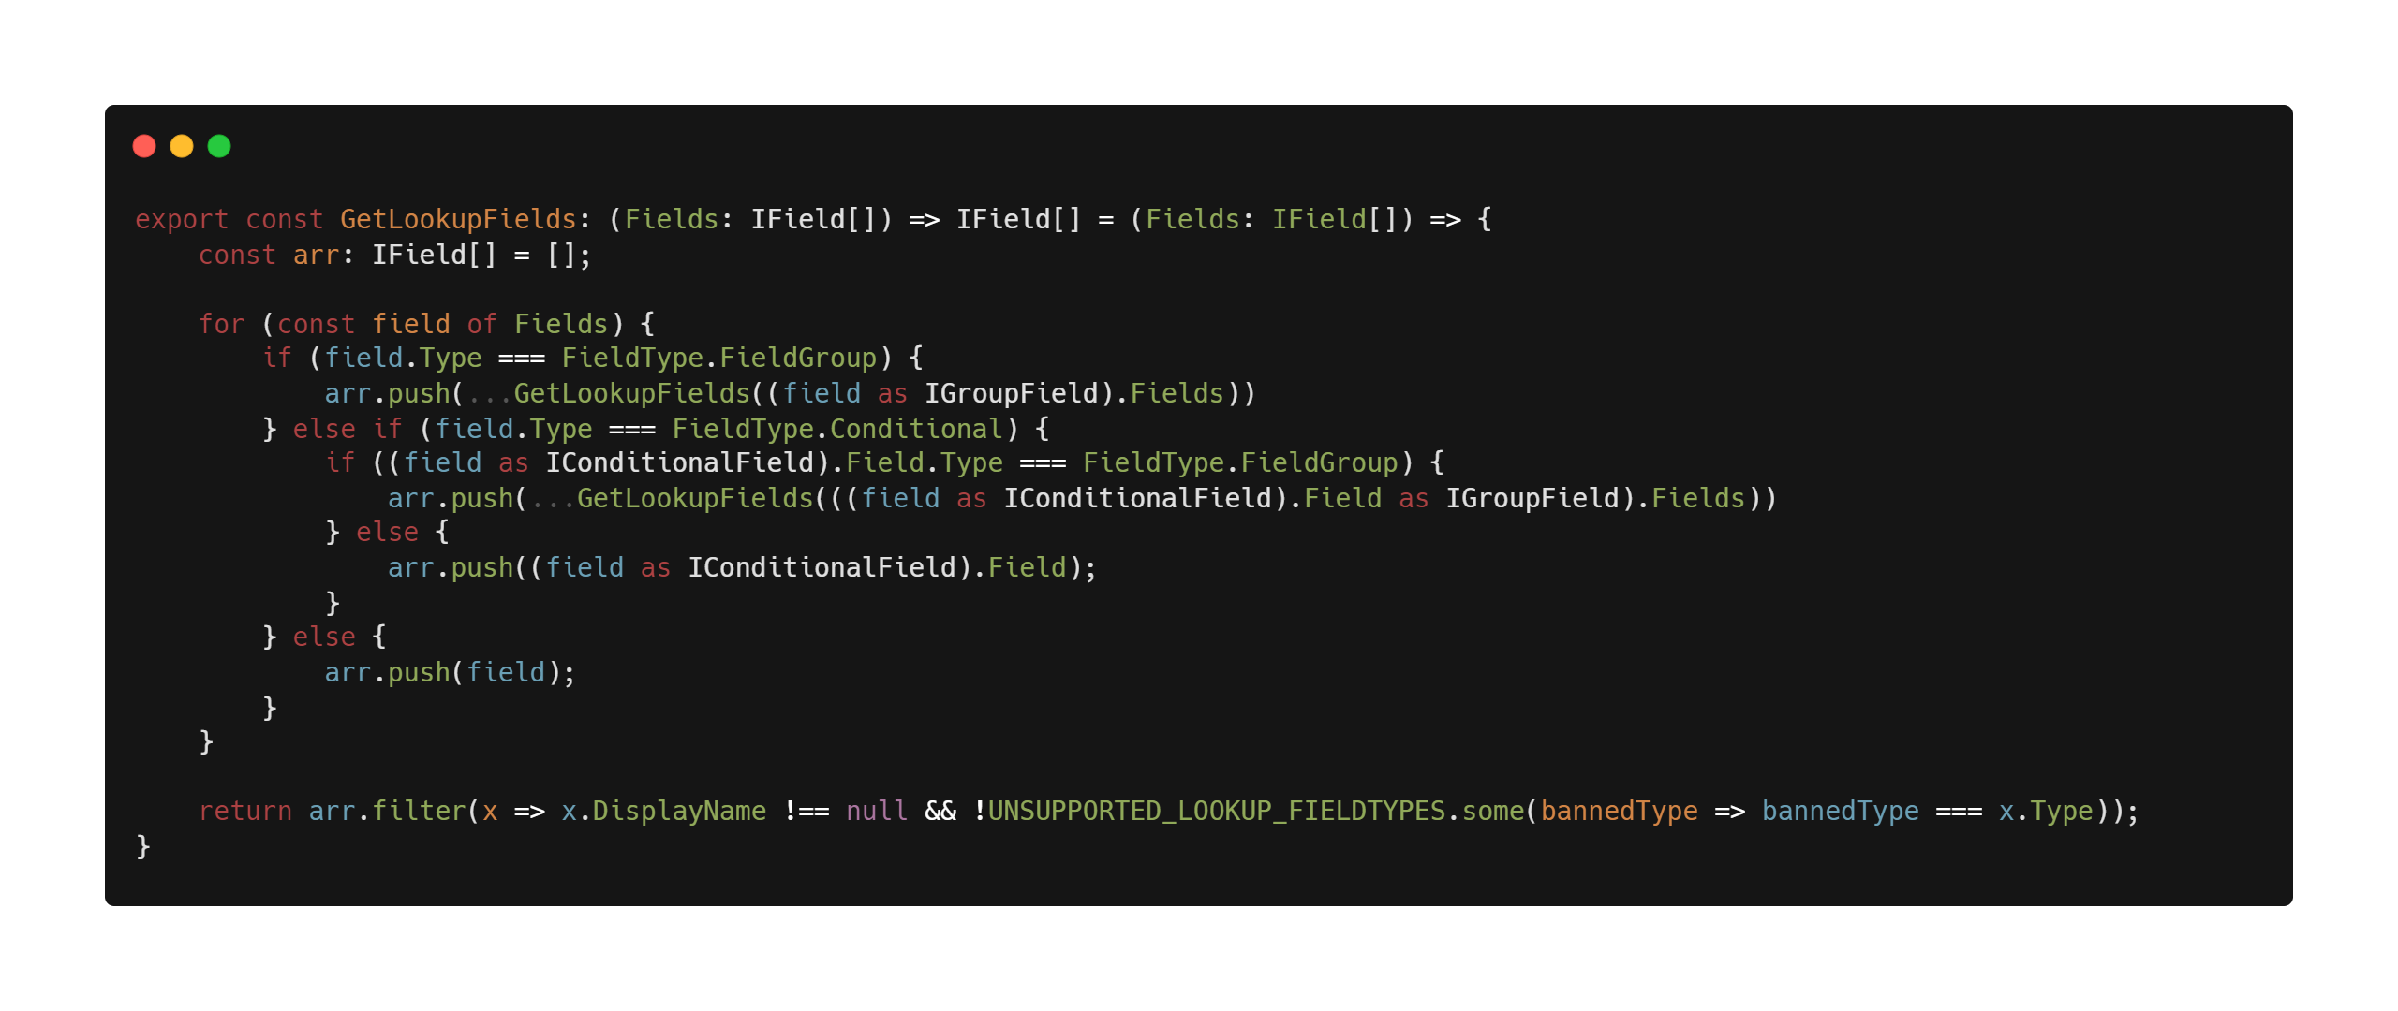
Notes:
Jeppe

Slide 8
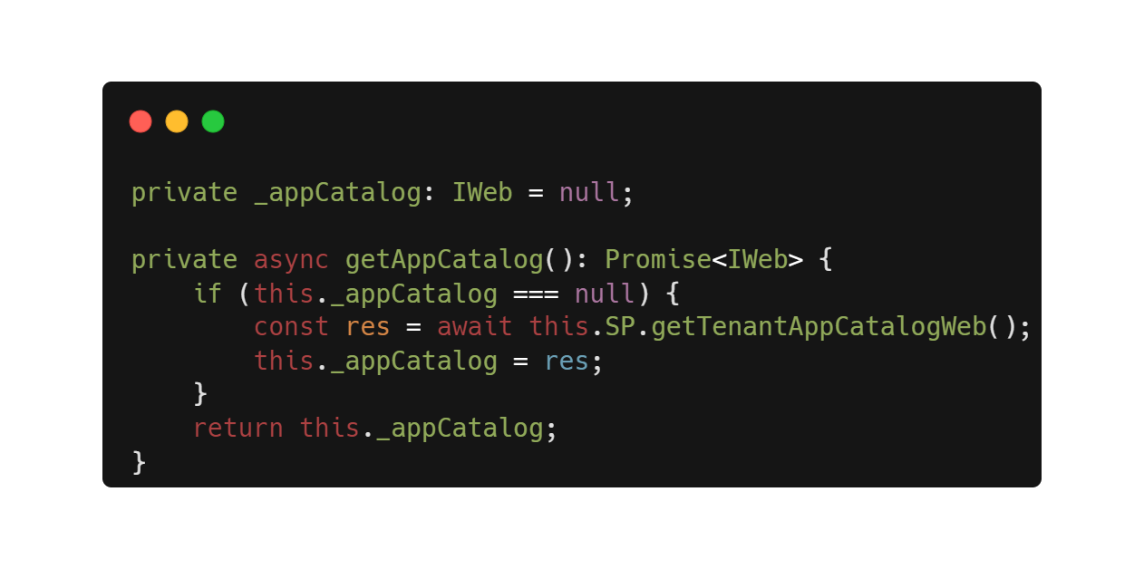
Step 1) Getting to the app catalog
PnPjs has our back here 🙌
Notes:
PnPjs has an easy feature to get the tenants app catalog

Slide 9

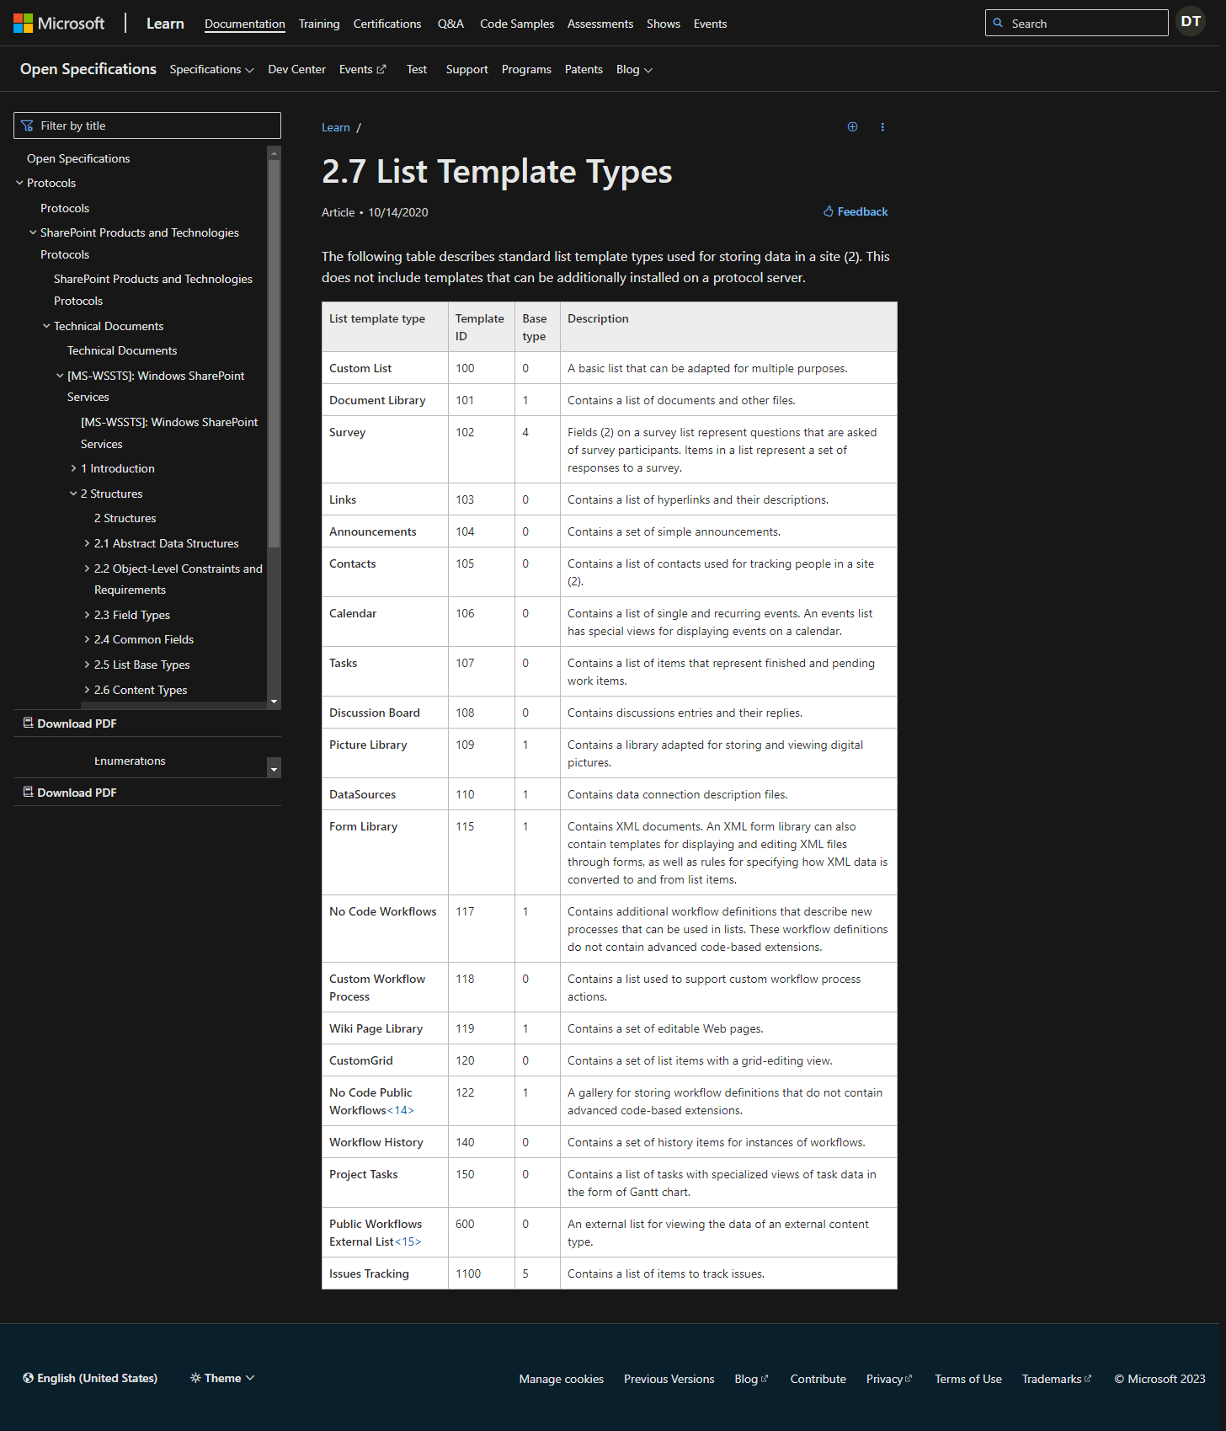
Step 2) Finding the “Tenant Wide Extensions” list
Where even the documentations is afraid to go!
https://learn.microsoft.com/en-us/openspecs/sharepoint_protocols/ms-wssts/8bf797af-288c-4a1d-a14b-cf5394e636cf
Notes:
Docs aren’t updated – there’s no complete list, even community provided ones included include this special list type

Slide 10
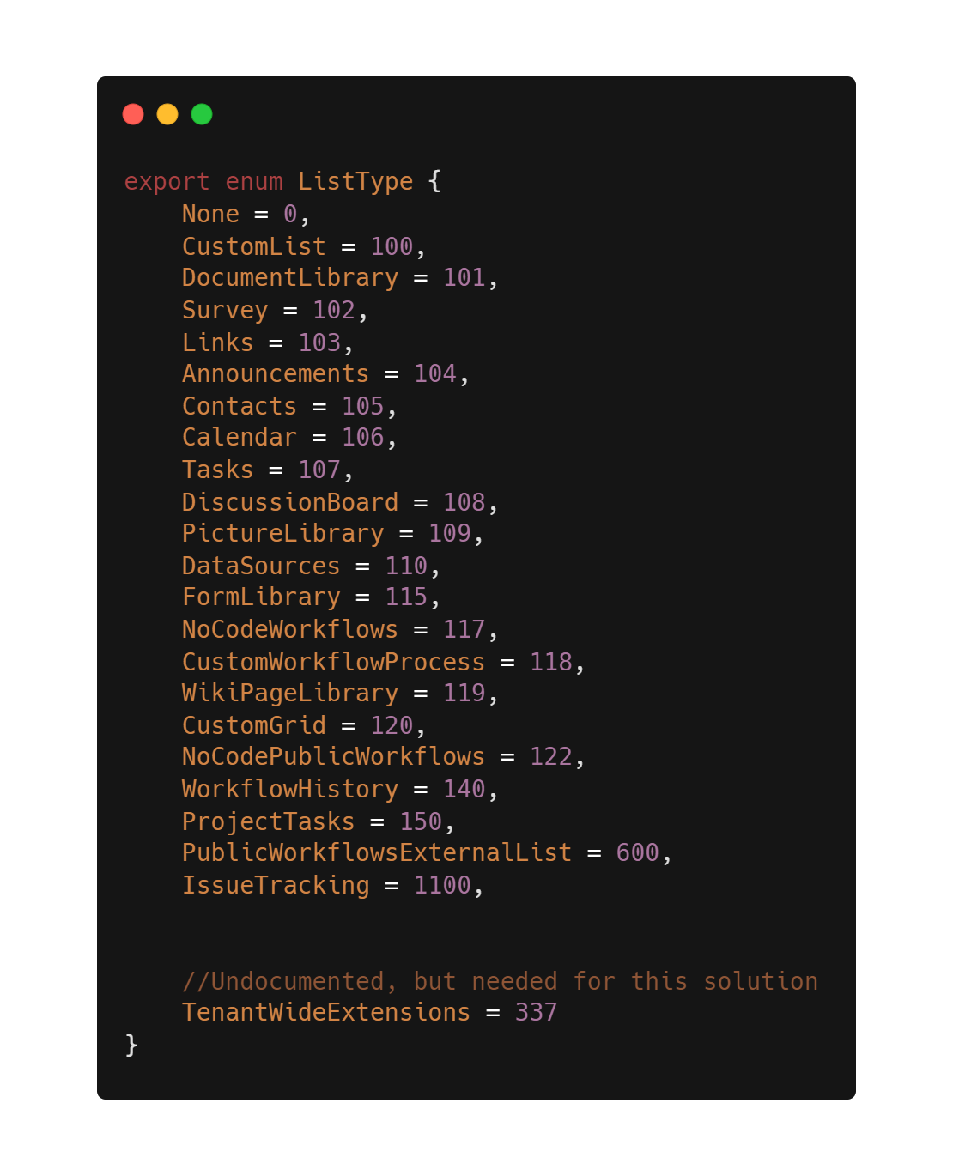
Step 2.1) The workaround
Mapping the official docs, and documenting your “hack”
Notes:
After querying the list – I found the Base template and validated on several tenant

Slide 11
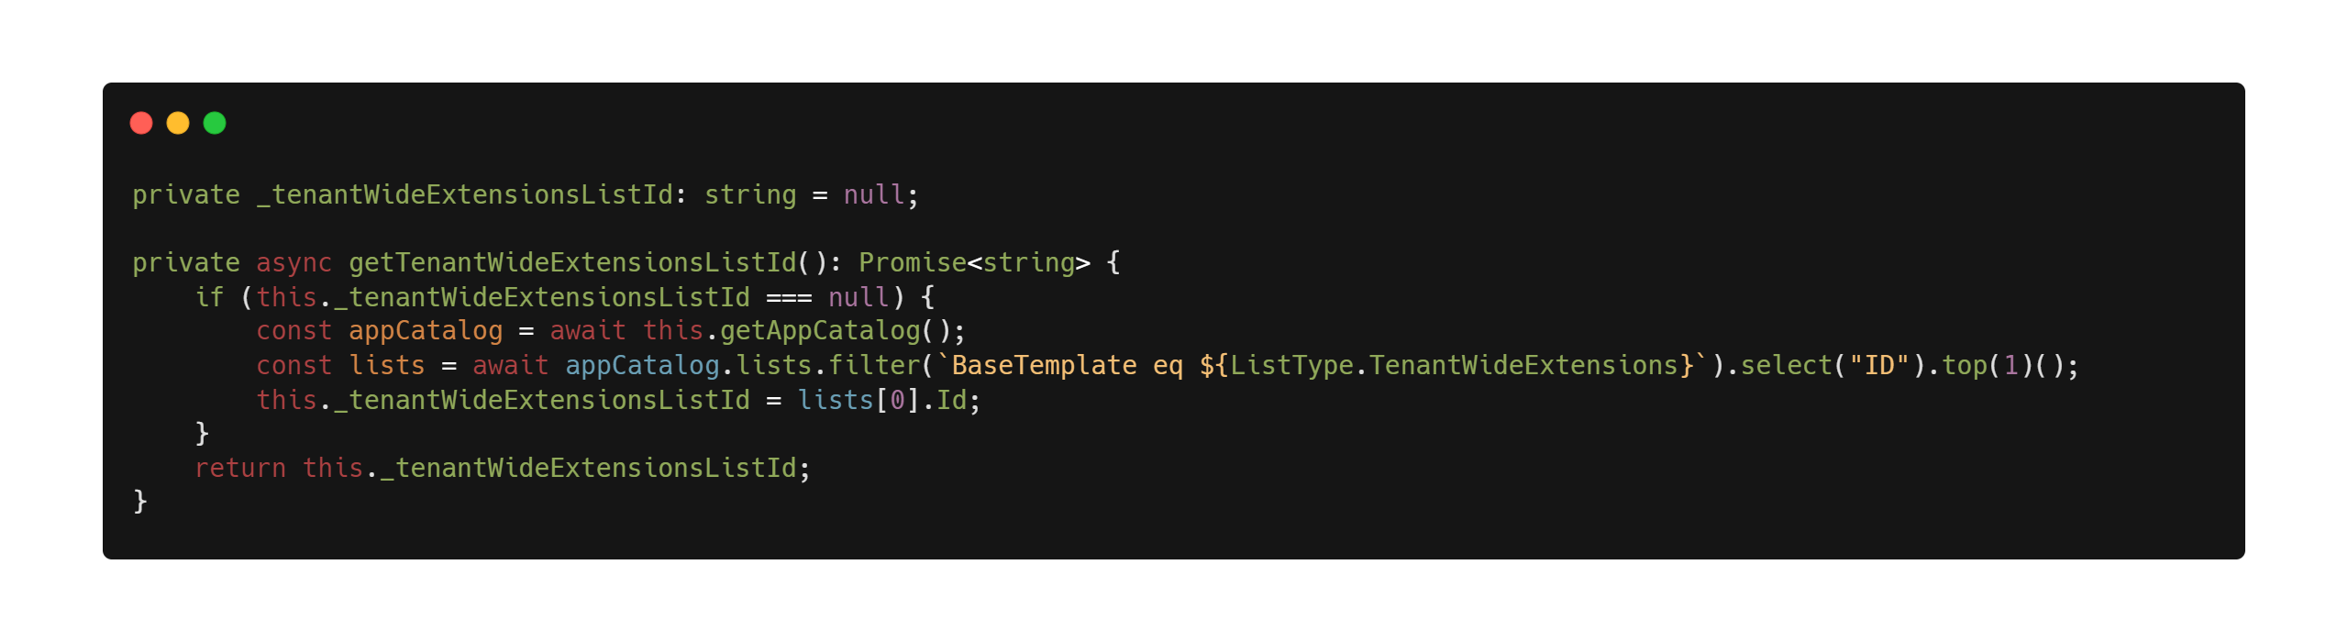
Step 2.2) Finally getting to the app catalog
OData filter with our newfound BaseTemplate Id – selecting only what we need!
Notes:
We can now easily query the list – and be warry of how we’re fetching the data we need! – the title is not a great solution, as it can be changed

Slide 12
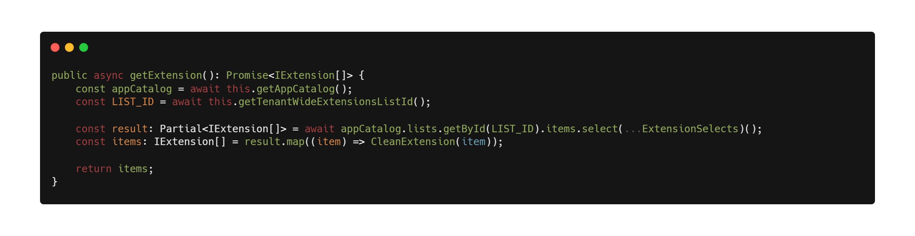
Step 3) The rest is just list items
Showing how Microsoft builds technology with their own tech 👀
Notes:
Again select what we need, trim the Odata properties in the next line

Slide 13

Summary
There is a “hidden” list containing the properties of your tenant wide deployed extensions
Extension properties are useful as they don’t require an API call to load initially
Sometimes the “unofficial” route is the best *cough* only route
We often have the most fun when we think “I wonder if ….”

Slide 14
Thank you!
Sample: https://github.com/pnp/sp-dev-fx-webparts/tree/main/samples/react-extension-manager
Slides: https://github.com/tanddant/slides
Dan Toft
Microsoft 365 Consultant Denmark
Blog.Dan-Toft.dk
@Tanddant

